Slide 1
GAME HACK
Victor Zhang, Shine Li

Slide 2
Purpose
Know yourself and the enemy

Slide 3
threat model
STRIDE

Slide 4
Approach
DLL injection

Slide 5
Dynamic Link Libraries (DLL)s
Shared Library
Parallel Access
Load-time/Run-time -> Mem
Modularity

Slide 6

Injection
(Insert Run-time Code snippets into targeted space

Slide 7
Attach to the process
Allocate Memory within the process
Copy the DLL or the DLL Path into the processes memory and determine appropriate memory addresses
Instruct the process to Execute your DLL

Slide 8
LoadLibraryEx/LoadLibraryA (Win32api)
Manual Mapping (Raw Binary without API)

Slide 9
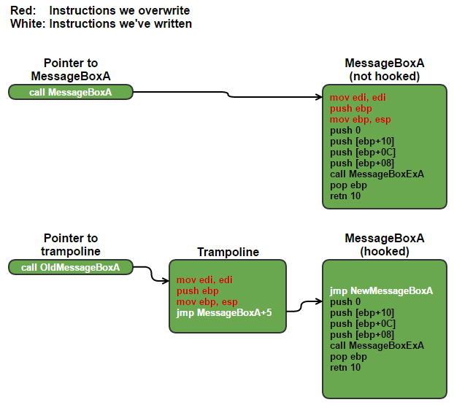
Hooking
Tap into different Module

Slide 10
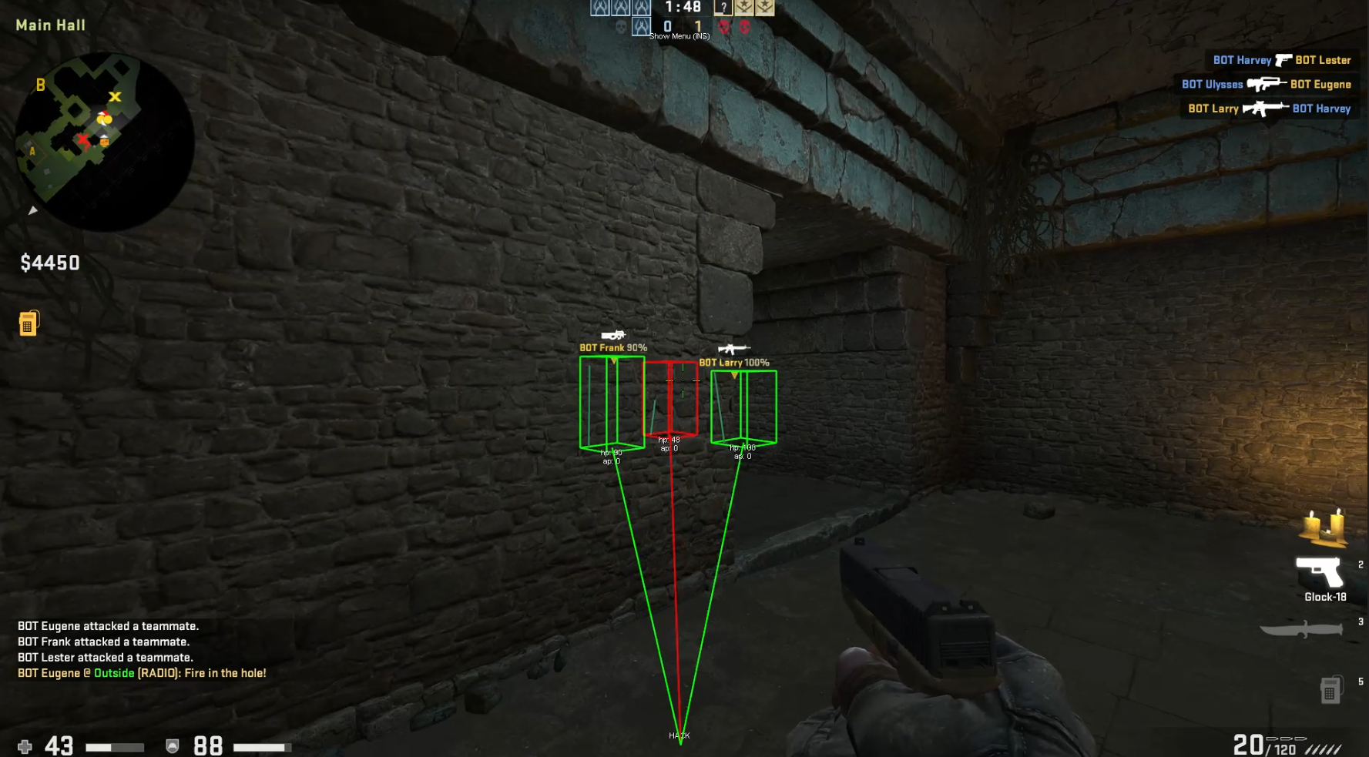
Demo Time

Slide 11
Future Work
Implement advanced anti-detection
Encrypt all strings
Randomize module, process, window & window class names
Use polymorphic code to evade signature detection
Stay off the disk as much as possible, stream everything into memory
Clean all your tracks, avoid registry keys etc…
Consider hooking and de-clawing VAC itself

Slide 12
Implement own DLL injector

